Slide 1

How can artificial intelligence help environmental problems?

Slide 2
Stages of Development
1
Planning
2
Design
3
Development
4
Documentation
5
Launch

Slide 3




Team
Hristo Rusev 9B
Role: Scrum-Trainer
Gabriel Yanchev 9B
Role: Front-end developer
Mitko Doychev 9B
Role: Front-end developer
Daniel Hristov 9B
Role: Designer

Slide 4
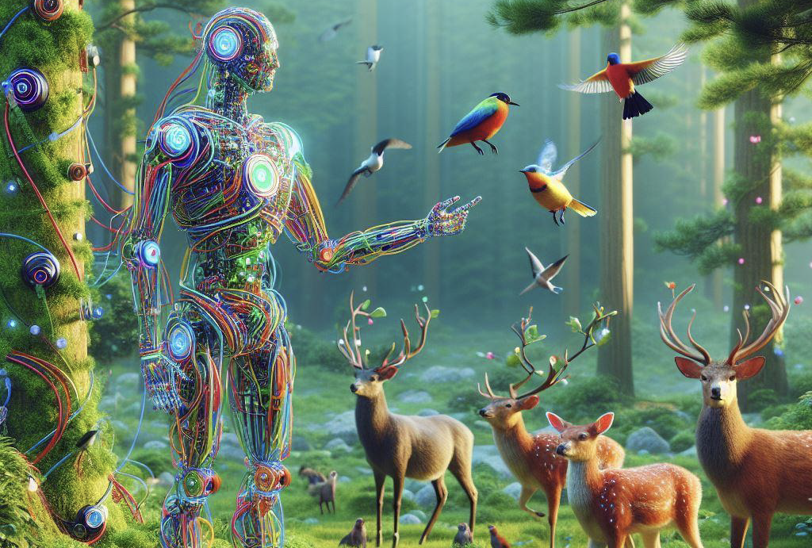

Our Main Idea of the website
In this site, we want to show you how artificial intelligence can help environmental problems.
For example, AI can optimize renewable energy, manage waste management, ocean conservation and natural disaster response.

Slide 5







Used Programs

Slide 6
Thanks for watching the presentation! Now let's see the website.

